Slide 1
Revenue
Quality of Earnings
Team Members:
Abhishek Goyal 16ucs009 Akash Agrawal 16ucs020 Kartikay Johari (wk) 16ucs089 Rahul Misra 16umm016 Shivansh Baijal 16ucs175 Shubham Samdani 16ucs181
08/11/2019

Slide 2
Key Takeaways
Understanding Revenue
What Customer needs
The Unholy Trinity
Quality Of Earnings

Slide 3
Purpose of running a company
Convert IDEAS into value proposition ($$$)
We sell a product to generate REVENUE.

Slide 4
Revenue
Total amount of income generated by the sale.
Also known as Gross Income
Revenue ≍ Income ≭ Profit
Profits = Revenue - Expenses
Profit is net income
Notes:
Income generated from sales.
Profit is net income.

Slide 5
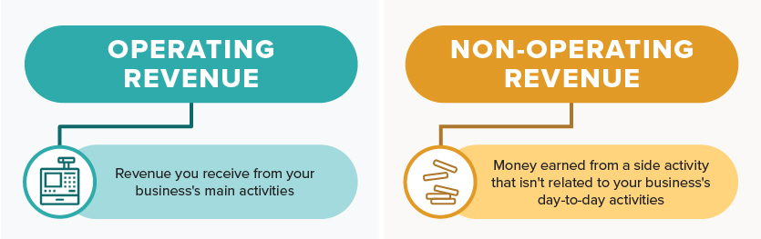
Types of revenue
Notes:
Only operating revenue.

Slide 6
Three crucial questions:
Who is our Kustomer?
What does a Kustomer want?
How can we add value to the Kustomer?
Notes:
Everything we do is for customers. //make a joke
K(C)ustomer is King. Never wrong. It is everything.
K/Q male/female put a crown over it.
Ceo manta

Slide 7
What Kustomer wants
Quality (value for money)
Cost (cheaper)
Availability (time)
… BETTER, CHEAPER, FASTER!!!
But difficult to manage them together (unholy trinity)
Notes:
Explain unholy trinity? Iphone11
Ceo resolve this. Apple is better not cheaper Samsung made it cheaper.

Slide 8
Quality of Earnings(QoE)
Quantity is not enough
Quality of revenue matters as well
The QoE refers to income generated from the core operations (operating) and doesn’t include the non-operating revenues.
Notes:
Quantity is not good enough

Slide 9
Features of Quality of Earning
Sustainability
Reliability
Bankability
Diversified Kustomers
Notes:
bankability

Slide 10
Why there is a need to check the Quality of Earnings?

Slide 11
Necessity to check
It is seen that net income does not represent the true financial picture of a company.
It may happen that a company reports a massive net income but we can’t say the company is financially sound just by this.

Slide 12
Factors Affecting Quality of Earnings
How the company is earning?
Conversion of sales to cash (faster) = High quality of earnings
By linked to outside sources = Low quality of earnings.
The degree to which earnings are cash or noncash
Notes:
Conversion of sales to cash = high quality
Time period is shorter, than re deploy faster again

Slide 13
Quality of Kustomers

Slide 14
Sustainability
What % of Kustomers repeat?
Repeated Kustomers indicate stable flow of revenue
Notes:
Cash sales and credit sales.
Bankability :

Slide 15
Reliability
What products are sold to Fortune 500 companies as they are more reliable than small buyers
Results in High Quality Earning

Slide 16
Bankability
How soon sales convert in cash?
Sales tied up in accounts receivable, not yet been realized.
Generating revenue but not cash = not profitable
Notes:
E.g. Earnings that are “tied up” in accounts receivable do not have much value because, despite being recognized, they have not yet been realized.

Slide 17
Diversification of Earnings
Suppose two companies selling same product but with different quantity of customers (say 50 and 5)
How do Investors distinguish between them :
Quantity
Stability of Revenue
Company with more customers is not heavily dependent on single customer
Notes:
How wide are customers. vulnerability

Slide 18
Export Earning
Korea, Germany : Heavily Dependent on exports
India, China : Less Dependent on exports

Slide 19
Conclusion
We achieve Greater Endorsement of the product’s quality.

Slide 20

QOE-Reliability
Case Study:
The US Pentagon has awarded Microsoft a $10bn cloud computing contract, beating out favourite Amazon, whose competitive bid drew criticism from US President Donald Trump.
Notes:
Bezos owns The Washington Post

Slide 21
References
To visit:
https://www.patriotsoftware.com/accounting/training/blog/what-are-types-of-revenue-accounts/
https://www.wallstreetmojo.com/quality-of-earnings/
https://www.investopedia.com/terms/q/qualityofearnings.asp
https://www.theguardian.com/global/2019/oct/26/pentagon-awards-10bn-cloud-computing-deal-to-microsoft-snubbing-amazon
To avoid:
https://www.quora.com/What-three-factors-affect-the-quality-of-earnings

Slide 22

Dedicated to
Future Kustomers

